Slide 1
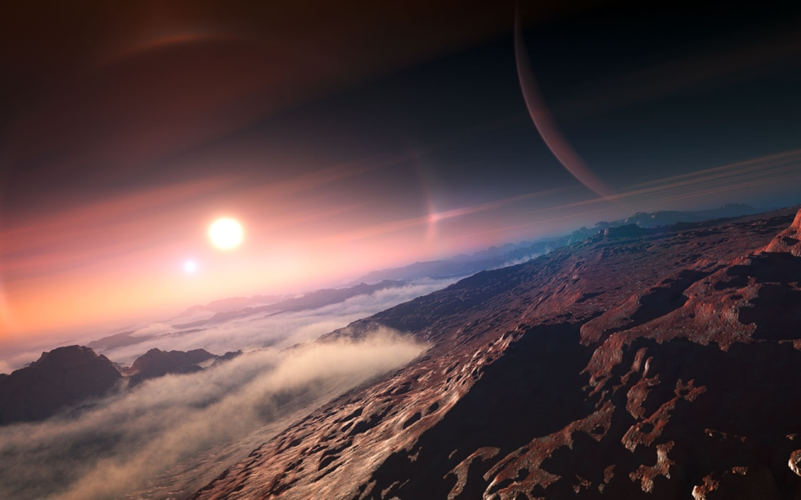
Atacama Desert as a Model for Hyper-arid Exoplanets
1
Alexa Drew
Dr. Damien Finn
Cadillo Lab

Slide 2
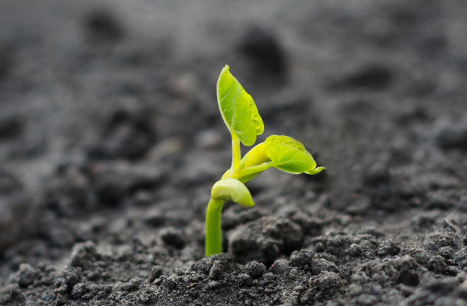
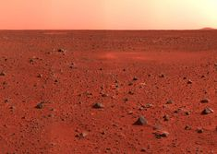
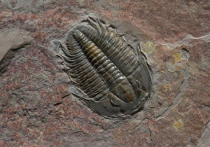
Introduction - Goals
Question: What might life be like on hyper-arid exoplanets and how might we find it?
1.) Predict traits of extraterrestrial life
2.) Determine how life survives
3.) Develop working biosignatures
2
3
4

Slide 3
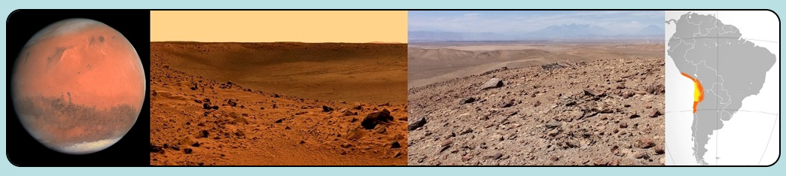
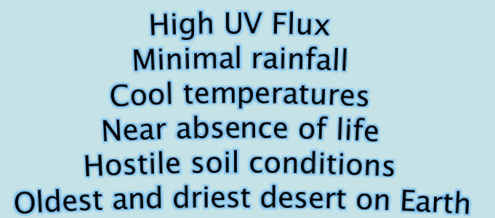
Background – Why the Atacama?
5
6
7
The Atacama is similar to the environments we are interested in

Slide 4
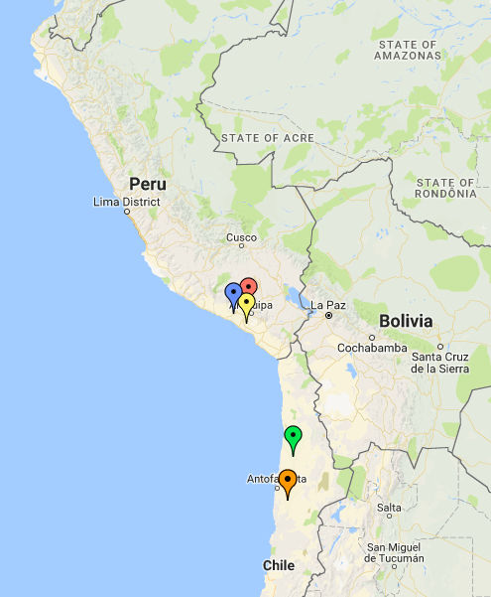
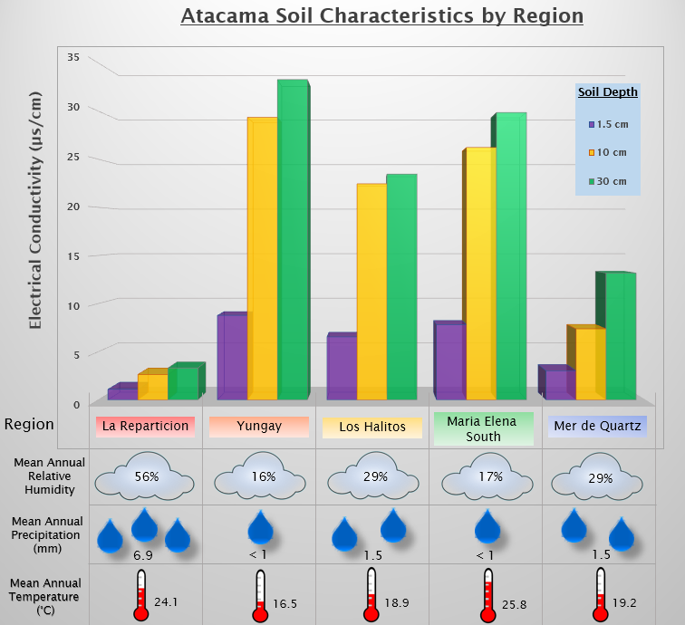
Methods – Soil Collection & Analysis
Location of soil sites; color matches name in table to the right

Slide 5
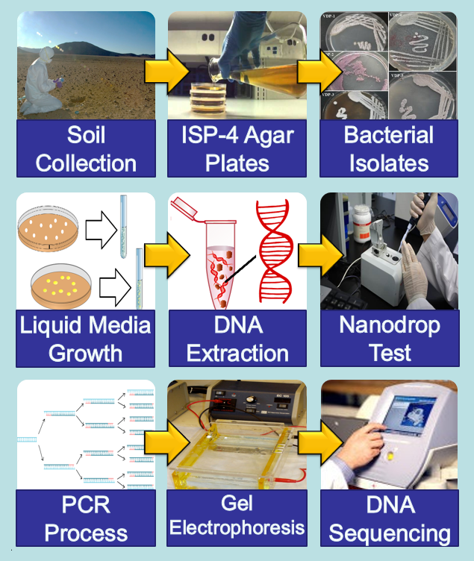
Methods – Isolates
Phase 1
8
9
10
  Isolate Growth
v
Phase 2
11
  DNA Extraction
Phase 3
12
13
  Replication & Analysis

Slide 6
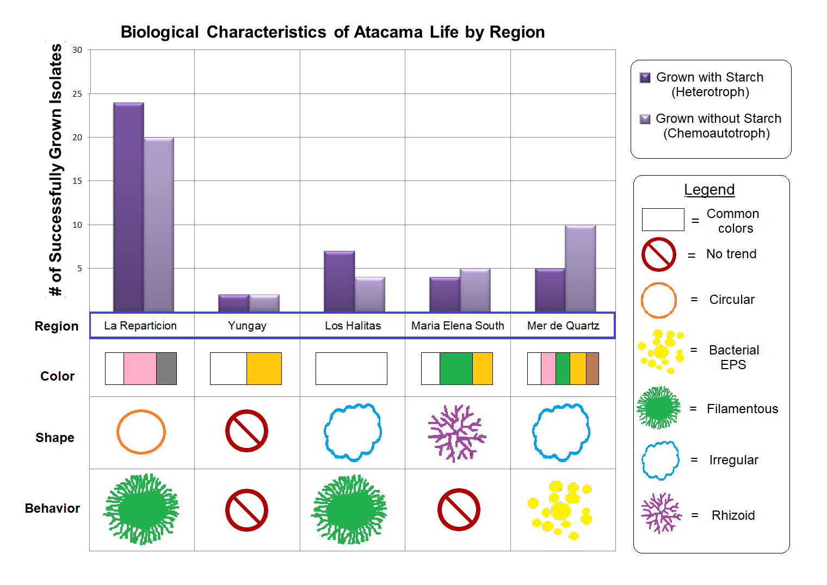
Results & Discussion – Isolate Traits
Higher annual precipitation results in more life
More Chemoautotrophs than Heterotrophs
Most isolates grew from surface soil

Slide 7
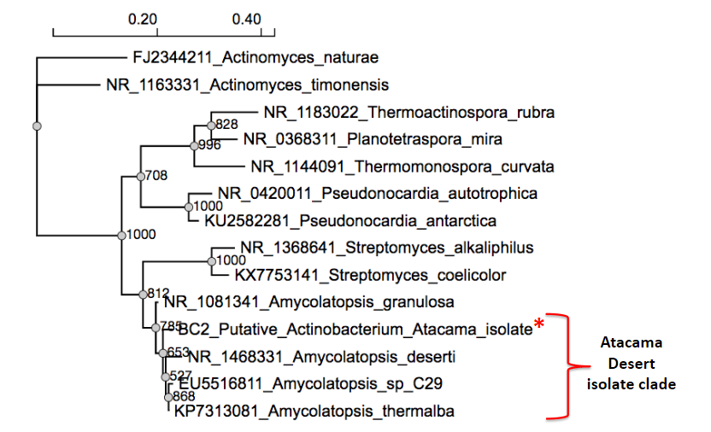
Results – Biological Identity
Similar to life found in other hyper-arid areas
Part of Actinobacteria phyla
Actinobacteria survive via atmospheric H₂
Potential C sources:
  Carbon Dioxide
  Carbon Monoxide
Phylogenic tree of a single isolate compared to phyla with similar evolutionary relationships

Slide 8

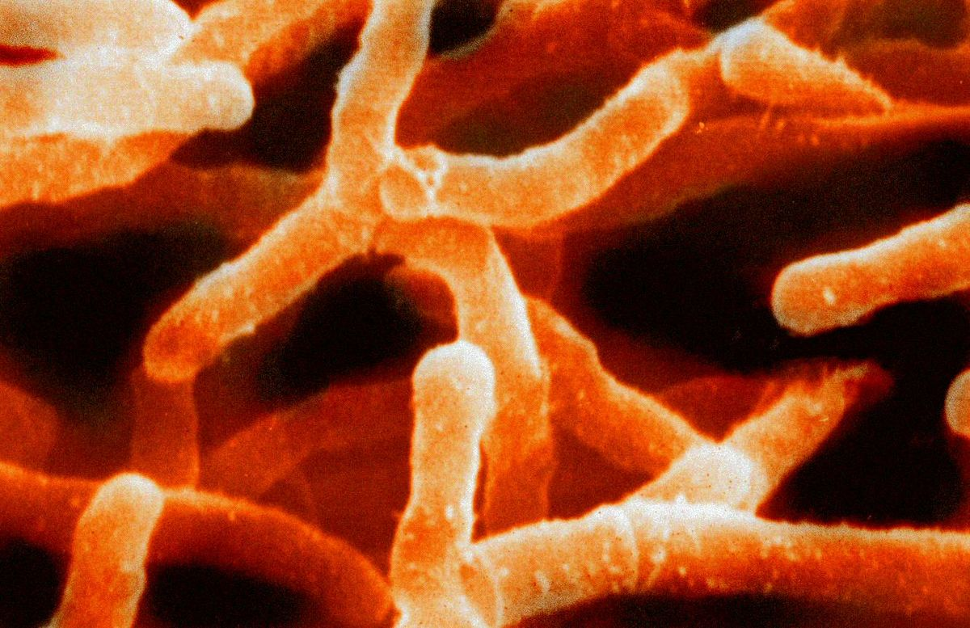
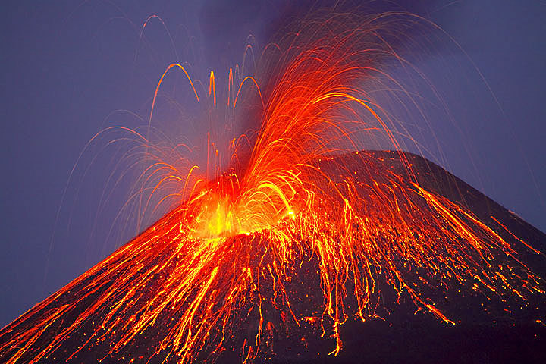
Conclusion – Next Steps
Data shows us what life might look like
Need more of the DNA sequenced
How do these life forms survive?
Analyze metabolic pathways
How can we find these life forms?
Biosignatures produce false positives
14
15
16

Slide 9

Acknowledgements
Dr. Damien Finn
Donald Glaser
Cadillo Lab
Dr. Hilary Hartnett
Desiree Crawl
Dr. Thomas Sharp
ASU NASA Space Grant
Matt Camargo
17

Slide 10

18

Slide 11
Image Sources
1 – https://www.newscientist.com/article/2139771-the-exoplanet-zoo-a-whistle-stop-tour/
2 – http://insanvekainat.net/2017/10/16/life-the-grand-mystery/
3 – https://www.spaceanswers.com/solar-system/why-is-mars-red/
4 – http://whataearth.com/product/trilobite
5 – http://www.damianpeach.com/marscolour.htm
6 – https://www.smithsonianmag.com/smart-news/mars-surface-may-be-toxic-bacteria-180963966/
7 – https://en.wikipedia.org/wiki/Atacama_Desert
8 – https://spacescience.arc.nasa.gov/story/sampling-for-biomarkers-in-the-atacama-desert/
9 – https://www.youtube.com/watch?v=rEMfRXr3wpc
10 – https://www.researchgate.net/profile/Vandana_Rathod2
11 – http://facdent.hku.hk/index.php/discovery/research-facilities/oral-biosciences/12 –
12 – https://en.wikipedia.org/wiki/Gel_electrophoresis
13 – https://www.thermofisher.com/us/en/home/brands/ion-torrent.html
14 – https://calvium.com/digital-dna-regeneration-project/
15 – https://en.wikipedia.org/wiki/Actinobacteria
16 – https://www.vergemagazine.com/tags/ecuador.html
17 – https://www.wired.com/2012/10/red-bull-stratos-launch-sunday/
18 – https://i.ytimg.com/vi/_Z0ZhzDRznw/maxresdefault.jpg

